Slide 1

ENTITY-RELATIONSHIP MODEL - 1
Continue …
CS204 Database System

Slide 2
Objectives
Entities and Attributes +
Initial Conceptual Design of the COMPANY Database +
Relationships +
CS204 Database System

Slide 3
- Entities and Attributes
Entity Types
Entity Sets
Key Attributes of an Entity Type
Value Sets (Domains) of Attributes
ER Diagrams for Entities and Attributes
CS204 Database System

Slide 4
Entity Types
A database usually contains groups of entities that are similar.
  Example: A company employing many employees stores similar information about each employee.
Entity type: is a collection (or set) of entities that have the some attributes.
  Example 1: Entity type EMPLOYEE has attributes such as
    Name
    DOB
    Salary
  Example 2: Entity type COMPANY has attributes such as
    Name
    Headquarters
    President
CS204 Database System

Slide 5
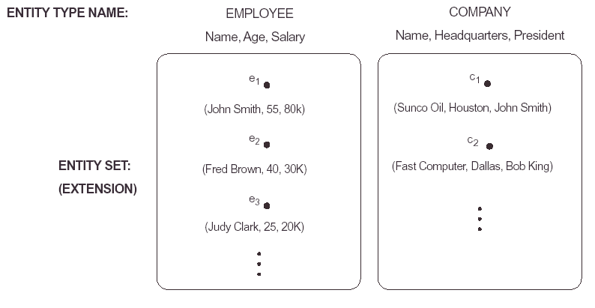
Entity Sets
The collection of all entities of a particular entity type in the database at any point of time is called entity set or just entity.
Entity types are also called the intension and entity sets are called the extension.
An extension of the previous examples are shown below:
CS204 Database System

Slide 6
Key Attributes of an Entity Type
Entity types must fulfill the key, or uniqueness, constraint on its attributes.
An entity type usually has an attribute whose value is distinct for each individual entity in the collection. Such attribute is called a key attribute or key identifier.
  Example: SSN is a key for EMPLOYEE entity type.
If a set of attributes posses the above property then their combination is called a composite key.
An entity that has no key of its own is called a weak entity and will be discussed later.
CS204 Database System

Slide 7
Value Sets (Domains) of Attributes
Each Single attribute of an entity type is associated with a value set (or a domain of values)
This domain specifies the set of values that may be assigned to that attribute for each individual entity.
Examples of domains:
  The domain of the Age attribute for the EMPLOYEE entity is the set of integers from 16 to 70.
  The domain of the Name attribute for the EMPLOYEE entity is the set of strings of alphabetic characters separated by blanks.
The value of attribute A for an entity e is denoted by A(e).
CS204 Database System

Slide 8
ER Diagrams for Entities and Attributes
ER diagrams are used to represent entity types, attributes of these types and the relationship between them.
In an ER diagram, an entity type is represented by a rectangular box enclosing the entity name.
Attribute names are enclosed in ovals and they are attached to their entity type by a strait line.
Composite attributes are attached to their attributes by straight lines.
Multi-valued attributes are enclosed by double ovals.
Key attributes of an entity are underlined in the ER diagram
CNIC
F. name
Phone
EMPLOYEE
Name
M. Init
L. name
Empno
Age
Notes:
Age is an aggregated or calculated column, with dash symbol
Empno and CNIC are key identifiers (Unique), but not PKs

Slide 9
Initial Conceptual design for the Company Database
From the requirements of the company DB we can identify the following entities:
  DEPARTMENT
  PROJECT
  EMPLOYEE
  DEPENDENT
In the next few slides, we will show how the above four entities together with their attributes are represented using ER diagram.
CS204 Database System

Slide 10
DEPARTMENT Entity Representation
An entity type DEPARTMENT has attributes:
  Name (key identifier)
  DNumber (key identifier)
  Locations (multi-valued attribute)
  Manager (EmpID) and
  ManagerStartDate.
ManagerID
ManagerStartDate
Name
DNumber
DEPARTMENT
Locations
CS204 Database System
Notes:
ManagerID means EmpID, a FK when linked with an Employee

Slide 11
PROJECT Entity Representation
An entity type PROJECT has attributes:
  Name (key identifier)
  DNumber (key identifier)
  Location
  ControllingDepartment
Name
ControllingDepartment
ProjID
PROJECT
Location
CS204 Database System
Notes:
ControllingDepartment means Project entity will be linked with Department with some relationship. This column will act as FK in Implementation
Project StartDate and EndDate, Total Budget are also required columns

Slide 12
EMPLOYEE Entity Representation
Entity Representation:
  An entity type EMPLOYEE with attributes: Name, SSN, Address, Salary, BirthDate, Department, Supervisor, and WorksOn. WorksOn is multi-valued composite attribute (project, Hours). SSN is the key attribute. Both name and address can be composite attributes.
Address
F. name
Supervisor
Sex
SSN
EMPLOYEE
Name
M. Init
BirthDate
L. name
Works_On
Salary
Department
Project
Hours
CS204 Database System

Slide 13
DEPENDENT Entity Representation
An entity type DEPENDENT (family members) has attributes:
  EmpID
  DependentName
  Sex
  BirthDate
  Relationship
BirthDate
DependentName
EmpID
Sex
DEPENDENT
Relationship
CS204 Database System
Notes:
When linked with Employee, EmpID will act as a FK (Identifying)

Slide 14
Relationships
Introduction to Relationship Types +
Relationship types and Instances +
Role names and Relation types +
Role names and Recursive Relationship types +
Constraints on Relationship Types +
Attributes of Relationship Types +
Relationship Representation in ER Diagram +
Higher Degree Relationships +
Examples +
CS204 Database System

Slide 15
Introduction to Relationship Type
By reviewing the initial design of the COMPANY DB example we can see the following:
  Some attributes of an entity reference other attributes in the same or other entities. For example, The attribute Department of the EMPLOYEE entity type refers to the DEPARTMENT entity that the employee works for.
  These are implicit relationships that exist between entity types.
  A better representation will be obtained if these are represented as relationships between the entity types rather than linking attributes.
Here we will describe another major component of ER model; namely relationships.
We will discuss relationship types, instances, degrees, and constraints on relationships.
CS204 Database System

Slide 16
Relationship Types and Instances…
Informally, a relationship type is a meaningful association among entity types.
A relationship (instance) is an association of entities where the association includes one entity from each participating entity type.
Mathematically, a relationship type (set) R between entity types E1, E2, …, En is a set of relationship instance ri, where each ri associates n individual entities (e1, e2, …, en); and each entity ei, in ri, is a member of the entity type Ej, 1<= j <= n.
The degree of a relationship is the number of entity types participating in that relationship.
CS204 Database System

Slide 17
Department & Employee
Section 2 > Data models
Consider Employees are working in departments:
  Department
  Employee
  Manager/ Boss??
  Employees are belong to Departments
  Some employees are managers of department
  Employee may work in more than one dept
  Some are the managers of other employees
Entities
Relationships
Notes:
Manager is a job title, it is not an Entity rather it is managed inside Employee

Slide 18
Basic Examples
MANAGES
EMPLOYEE
DEPARTMENT
BELONGS TO
Employee
DEPARTMENT
MANAGES
EMPLOYEE
DEPARTMENT
BELONGS TO
Emp belongs to Dept (N-1)
CS204 Database System
Notes:
Make separate diagrams and then consolidate/ combine into one. Refine and go up to revisions from first draft.
Employee works for Department means M-N

Slide 19
Basic Examples …
Offered with
Course
Book
Hours
WORKS_ON
EMPLOYEE
PROJECT
CS204 Database System
Notes:
Rate is required with hours

Slide 20
Assigning Attributes and Relationships
Student
Semester
Course
Project
Faculty
Building
Invoice/ Orders
Person
Car
Items
Department
Employee
PurchaseOrder
Customer
Orders
CS204 Database System

Slide 21
More Basic Examples
drives
Person
Car
owns
Person
Car
Married
Husband
Wife
Can married with
CS204 Database System
Notes:
Person & Car (1-1: drives at a time or M-N same car cannot be driven by same person again)
Person & Car (1-M: owns)
Husband & Wife (1-1 or 1-4)
Columns of Husband and wife will be same then later this relationship will be recursive, means wives are under Husband

Slide 22
Example (Emp, Dept & Project)
Employees are working in departments, each employee belongs to department and may work in projects controlled by the department.
Prepare Questions (Relationships)
Validate with the help of Datasets (Tables) - Mapping
CS204 Database System
Notes:
Datasets with fewer records and keys are required

Slide 23
Example (Purchasing Items)
Customer is placing an order to buy items with sold qty and price
Prepare Questions (Relationships)
Keep in your mind the Invoice
Validate with the help of Datasets (Tables) - Mapping
CS204 Database System
Notes:
Datasets with fewer records and keys are required
Invoice can be collected from any store Metro, or get samples from Google Images
Design it for the Enterprise

Slide 24
Getting started 1-M relationship ...
Student
Book
Any One student borrows many books
When another student borrows same book after returning book in library, over writing roll number on previous borrower’s roll number is a WRONG way!
1-M relationship will be invalid relationship!
Make at least 3 versions of one ER Model to get optimum solution
CS204 Database System

Slide 25
Getting started 1-M relationship
Student
Semester
Any One student registers in more than one semester
In any one semester, many students can register
Only registering semester is not fully meaningful, students have to register in course(s) along with semester
Some students may fail in course and re-register in same course!
CS204 Database System

Slide 26
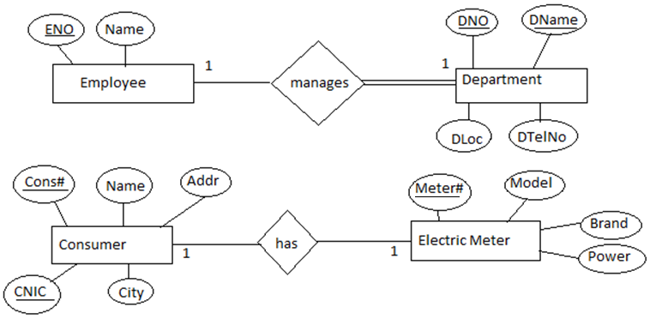
Simple 1-1 Relationships
CS204 Database System
Notes:
2nd diagram requires corrections or enhancement, Consumer name may create redundancy.

Slide 27
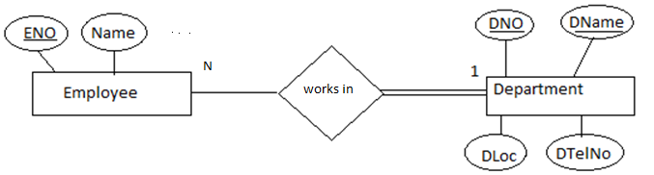
Simple 1-N Relationship with Total Cardinalities
Other examples are Customer & Orders, Patient & Visits
CS204 Database System
Notes:
It is appropriate to mention belongs-to (or has) instead of works-in. (Works-in: M-N and Belongs-to: N-1)

Slide 28
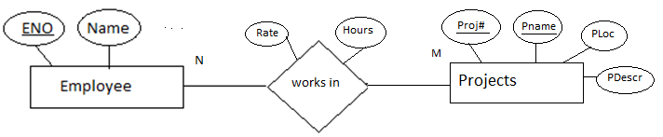
Simple M-N Relationship
Other examples are Orders & Items, Course & Semester
CS204 Database System

Slide 29
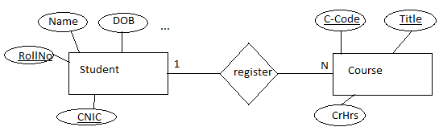
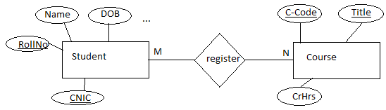
How to analyze & make ternary relationships
Analyse and decide above ER is correct or not? NOT
What happen if student fails in a course and re-register in another Semester?
CS204 Database System
Notes:
You need to complete this example by course offering and course registration

Slide 30
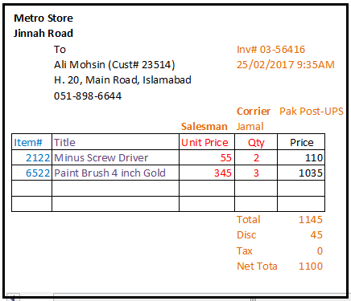
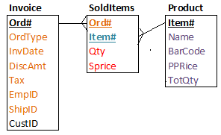
M-N Extended Example
When Customer is purchasing any thing …
CS204 Database System
Notes:
Order and invoice are same. Buying is only possible using order or invoice. If we make ternary relationship of Customer, Invoice & Item then what are the drawbacks or deficiencies in design

Slide 31
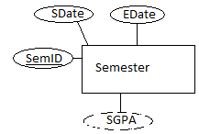
How to analyze & make ternary relationships ...
Join Semester with Student & Course with common relationship, why?
Exercise: How to offer courses to students in a semester?
Hint: Solution-1: Section will be a column on relationship
Solution-2: Make entity CourseSection(Section#, Descr);
Section# contains CA, CB, ... LA, LB, ...
Descr contains Class section-A, Lab section B, ...
CS204 Database System

Slide 32
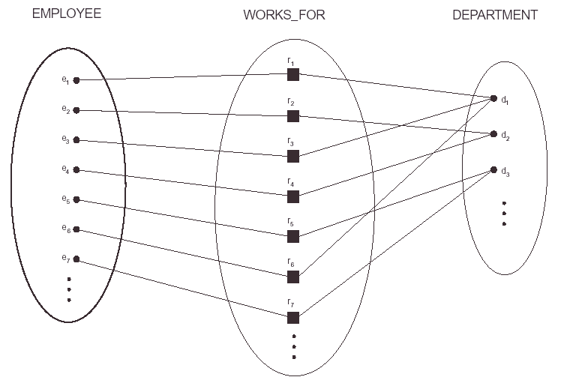
Relationship Types and Instances
For example, lets look ate the relationship type WORKS_FOR between the two entities EMPLOYEE and DEPARTMENT, which associates each employee with the department he works for.
Each relationship instance in the relationship set WORKS_FOR (has) associates one EMPLOYEE entity and one DEPARTMENT entity as shown in the figure below.
Any one department has one or more employees. Each Employee has one department
CS204 Database System
Notes:
This is not ER Diagram

Slide 33
Role Names and Relation Types
Each entity type that participates in a relationship type plays a particular role in the relationship.
For example, in the WORKS_FOR relationship type, EMPLOYEE plays the role of employee or worker and DEPARTMENT plays the role of department.
In most of the cases, the name of the entity type can be used as the role name of that entity type in the relationship type it participates in, a shown in the previous example.
CS204 Database System

Slide 34
Role Names and Recursive Relations …
In some cases, the same entity type participates more than once in a relationship roles. In such cases the role name becomes essential for distinguishing the meaning of each participation. Such relationship type are called recursive relationships.
For example, the SUPERVISOR relationship type relates an employee to a supervisor, and both belongs to the EMPLOYEE entity type, as shown in this figure.
CS204 Database System

Slide 35
… Role Names and Recursive Relations
EMPLOYEE
WORKS_FOR
e_{1 }
e_{2 }
e_{3 }
e_{4 }
e_{5 }
e_{6 }
e_{7 }
r₁
r₂
r₃
r₄
r₅
r₆
2
1
1
2
2
1
2
1
1
2
1
2
1: Supervises
2: Supervised
CS204 Database System

Slide 36
Role Names and Recursive Relations …
EMPLOYEE
SUPERVISION
1
e1
r1
1
2
e2
1
r2
2
e3
1
r3
2
r4
e4
e5
2
e5
…
…
…
…
…
1: Supervises
2: Supervised
CS204 Database System

Slide 37
Constraints on Relationship Types
Relationship types usually have some constraints that limit the possible combination of entities that may participate in the corresponding relationship set. These constraints are obtained from the mini-world situation that the relationship represents.
For example, if we have a rule in the COMPANY stating that an employee can work for one department only, then we should be able to represent this constraint.
Two main types of restrictions on relationships are:
  cardinality and
  Participation
CS204 Database System

Slide 38
Cardinality (Ratio) Constraints
Determines the number of possible relationships for each participating entity.
For example, in the relationship type WORKS_FOR, the cardinality ratio of DEPARTMENT:EMPLOYEE is 1:N, meaning that each department can be related to (employs) many employees but an employee can be related to (works for) only one department.
Most common degree for relationships is binary with cardinality ratios of one-to-one (1:1), one-to-many (1:n), or many-to-many (N:M).
CS204 Database System

Slide 39
One-to-many(1:N) or Many-to-one (N:1) RELATIONSHIP
WORKS_FOR (Belongs-to)
EMPLOYEE
DEPARTMENT
r₁
r₂
r₃
r₄
r₅
r₆
e_{1 }
e_{2 }
e_{3 }
e_{4 }
e_{5 }
e_{6 }
e_{7 }
● d₁
● d₂
● d₃
Any one department has one or more employees.
Some Employees may not belong to department

Slide 40
Participation Constraints
Determines whether the existence of an entity depends on its being related to another entity through the relationship.
An entity is either totally or partially participating in a relationship.
For example, if the company policy states that each employee entity can exist only if it participates in a WORKS_FOR relationship instance. Thus, the participation of the employee entity in the relationship WORKS_FOR is total. Total participation is also called existence dependency.
However, only some employees manage departments in the company. Therefore, we say that the participation of the EMPLOYEE entity in the relationship MANAGES is partial.
CS204 Database System

Slide 41
Example of Partial/Total Relationship
EMPLOYEE
MANAGES
DEPARTMENT
e1
e2
d1
r1
e3
r2
d2
e4
r3
d3
…
e5
…
…
…
…
…
…
CS204 Database System

Slide 42
Attributes of Relationship Types
Relationship types can have their own attributes similar to the entity types.
For example, to record the number of hours per week that an employee works on a particular project, we can include an attribute Hours for the relationship type WORK_ON between EMPLOYEE and PROJECT entity types.
Another Example, is to include the date on which a manager starts managing a department via an attribute StartDate for the relationship type MANAGES between EMPLOYEE and DEPARTMENT entity types.
CS204 Database System

Slide 43
Relationship Representation in ER Diagram
Relationship types can have their own attributes similar to the entity types.
For example, to record the number of hours per week that an employee works on particular object, we can include an attribute Hours for the relationship type WORK_ON between EMPLOYEE and PROJECT entity types.
Another example, is to include the date on which a manager starts managing a department via an attribute StartDate for the relationship type MANAGES between EMPLOYEE and DEPARTMENT entity types.
StartDate
1
1
DEPARTMENT
EMPLOYEE
MANAGES
CS204 Database System

Slide 44
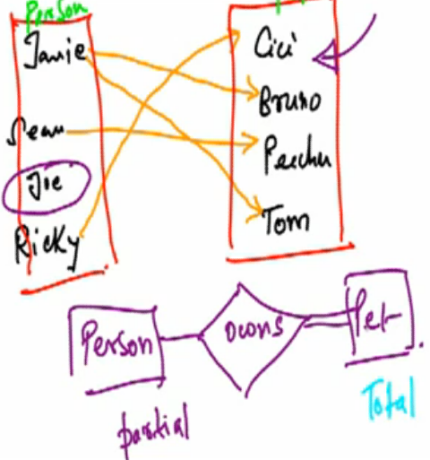
Partial & Total Entities
5-<number>
CS204 Database System

Slide 45
Higher Degree Relationships
In many instances, it is required to represent relationship that is of a degree higher than 2 (HD), i.e. it involves more than two entity types.
Sometime these relationships can be represented using binary relations, although sometime this may not give the same meaning.
For example the tuple (s, p, j) which states that SUPPLIER s supplies PART p to PROJECT j may not be expressed by the three tuples (s,p), (s,j) and (p,j).
CS204 Database System

Slide 46
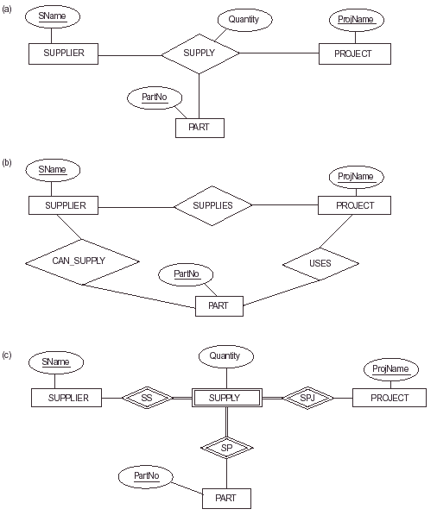
Example: Higher Degree Relationships
Other Examples are: Student, Semester, Course; Instructor, Semester, Course;
Candidate, Company, Interview; Campus, Departments, Schools for our univ.)
CS204 Database System
Notes:
Option a, ok if supplier supplies part one time to a project. If same part is supplied by same supplier in same project again then c is the correct solution
For datasets: One supplier supplies different parts to same or different projects

Slide 47
Examples
Example of Participation Constraint
  Partial/Total Relationship
Examples of Cardinality Constraint
  One-to-One
  One-to-Many
  Many-to-Many
CS204 Database System

Slide 48
Partial/Total Relationship
EMPLOYEE
MANAGES
DEPARTMENT
e1
e2
r1
d1
e3
d2
r2
e4
e5
r3
d3
StartDate
1
1
DEPARTMENT
EMPLOYEE
MANAGES
Partial participation
Total participation
CS204 Database System

Slide 49
One-to-One (1:1) Relationship
EMPLOYEE
Manages
DEPARTMENT
e1
r1
d1
e2
r2
d2
e3
r3
d3
e4
r4
d4
e5
r5
d5
EMPLOYEE
manages
DEPARTMENT
1
1
Cardinality is 1:1
CS204 Database System

Slide 50
One-to-many(1:N) or Many-to-one (N:1) Relationship
has
EMPLOYEE
DEPARTMENT
e1
r1
d1
e2
r2
e3
r3
d2
e4
r4
d3
e5
r5
EMPLOYEE
has
DEPARTMENT
N
1
Cardinality is N:1
CS204 Database System

Slide 51
Many-to-many (M:N) or Many-to-Many (N:M) Relationship
EMPLOYEE
WORKD_FOR
DEPARTMENT
e1
r1
d1
e2
r2
e3
r3
d2
e4
r4
d3
r5
EMPLOYEE
WORKS_FOR
DEPARTMENT
M
N
Cardinality is M:N
CS204 Database System

Slide 52
Other Examples are
Employee and Dependents (1-M)
Customer and Order (Invoice) (1-M)
Category and Products (1-M)
Wife and Husband (1-1)
Person and Car with drive relationship (1-1)
Banks have their branches
Semester offers courses
Employee or student has badge
Employee has computers
Employee has skills
Invoices and product purchased
Supplier supplies products
Plant has storages in factory
CS204 Database System

Slide 53
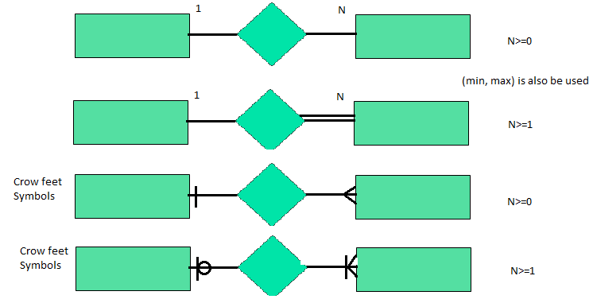
Alternate Cardinalities Symbols (Erwin/ Crowfeet)
CS204 Database System

